Slide 1
NON-LINEAR MODELS AND REGULARIZATION

Slide 2
Tasks
 | Output = continuous | Output = discrete
Supervised | Regression | Classification
Unsupervised | Dimensionality reduction | Clustering
Solutions
Hierarchical,
Non-linear Model
Deep NN
Bayes, Logistic
Regularized
Regression
Non-linear Model
Linear Regression
k-NN
Linear Model
Linear
Regression
K-means
PCA

Slide 3
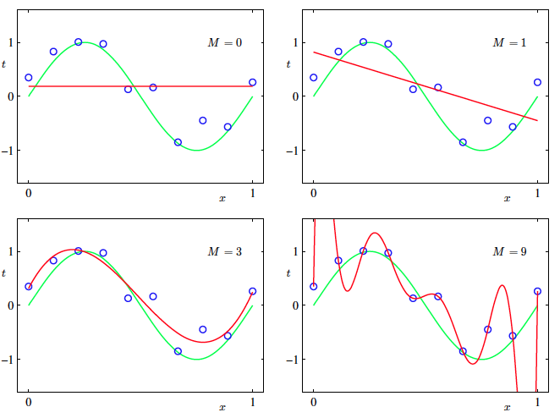
Power of Non linear models

Slide 4
MODEL SELECTION: How to CHOOSE MODEL ORDER

Slide 5
Approach 1: Validation data
The order of the polynomial is a hyper parameter
One way to find it is to use validation data
Plot loss w.r.t polynomial order
Pick the order where there is a minima

Slide 6
MODEL SELECTION: BIAS VARIANCE DILEMMA

Slide 7
Power of Non linear models

Slide 8

Reading: B6 Section 4.7

Slide 9
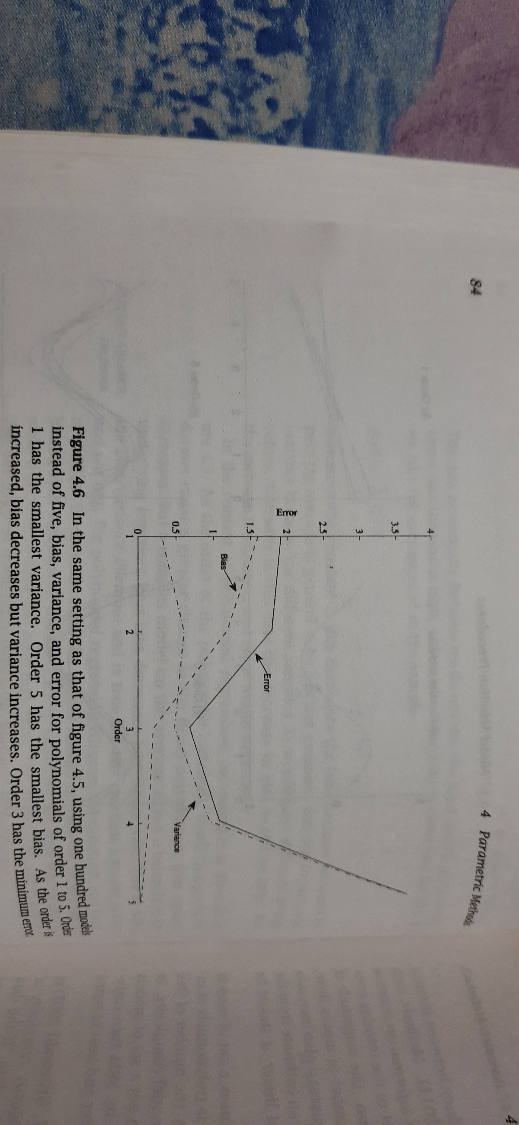
Reading: B6 Section 4.7

Slide 10
Reading: B6 Section 4.7

Slide 11
MODEL SELECTION: REGULARIZATION

Slide 12
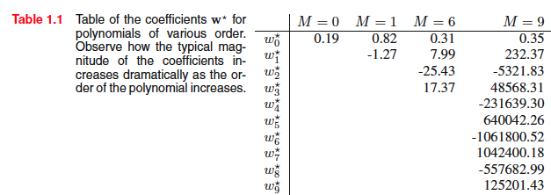
Approach 2: regularization
Control Rod: Regularization

Slide 13
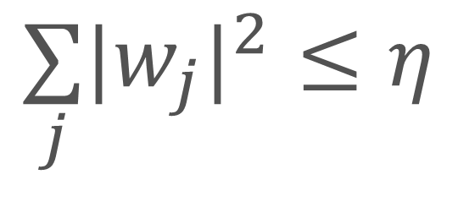
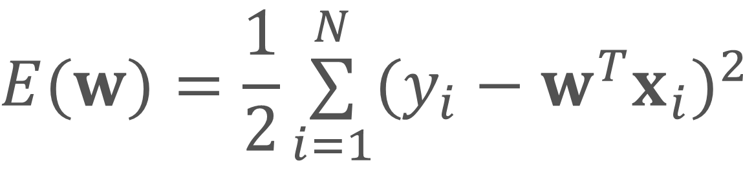
Constrained VS unconstrained cost fn.
Reading: B1 - 5.3, 5.4, 5.5, 5.7
Constrained minimization
$$E(w)=\frac{1}{2}\overset{N}{\underset{i=1}{∑}}(y_{i}−w^{T}x_{i})^{2}$$
$$\underset{j}{∑}|w_{j}|^{2}≤η$$
Constrained optimisation
One inequality constraint

Slide 14
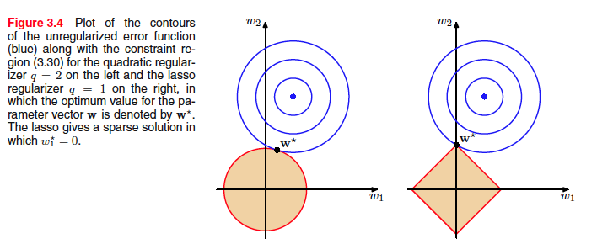
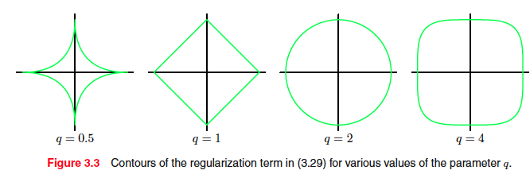
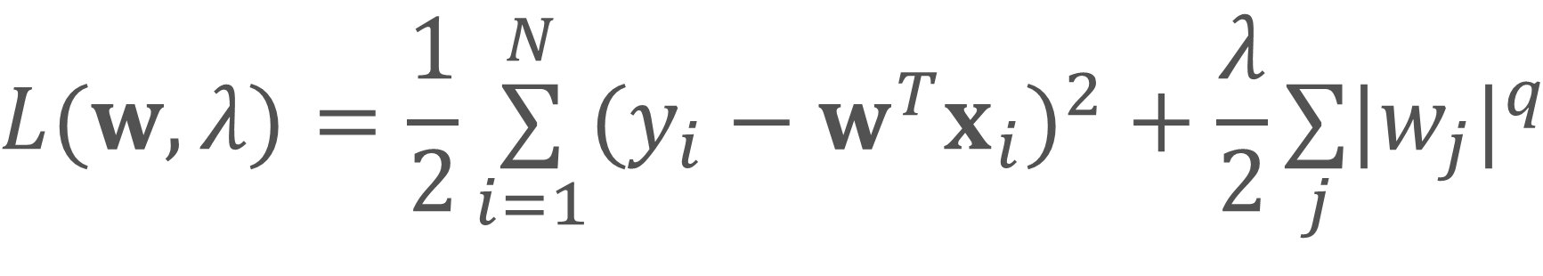
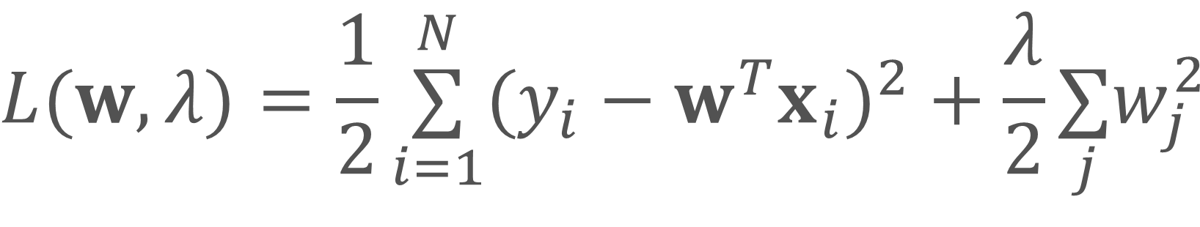
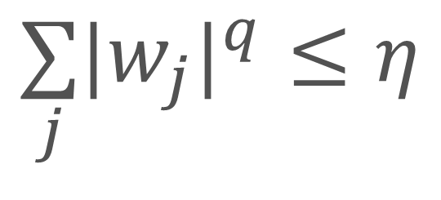
Lagrangian - Regularised regression
Reading: B1 - 5.3, 5.4, 5.5, 5.7
$$L(w,λ)=\frac{1}{2}\overset{N}{\underset{i=1}{∑}}(y_{i}−w^{T}x_{i})^{2}+\frac{λ}{2}\underset{j}{∑}|w_{j}|^{q}$$
Constrained minimization
$$E(w)=\frac{1}{2}\overset{N}{\underset{i=1}{∑}}(y_{i}−w^{T}x_{i})^{2}$$
$$L(w,λ)=\frac{1}{2}\overset{N}{\underset{i=1}{∑}}(y_{i}−w^{T}x_{i})^{2}+\frac{λ}{2}\underset{j}{∑}w_{j}^{2}$$
$$\underset{j}{∑}|w_{j}|^{q}≤η$$

Slide 15


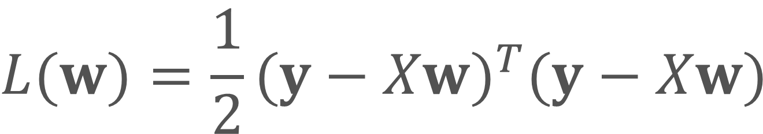

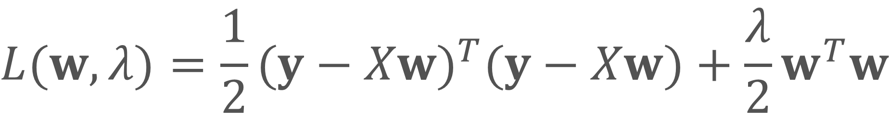

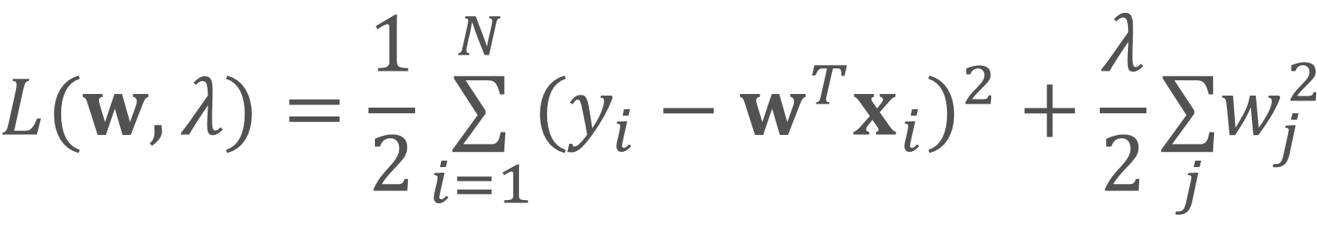
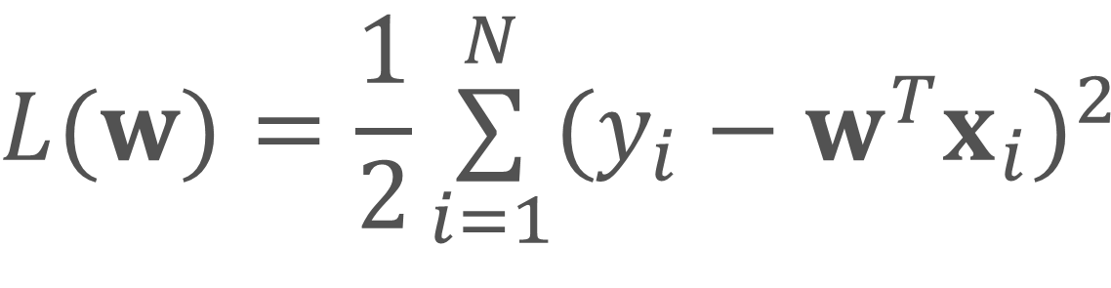
Regularized regression
$$L(w)=\frac{1}{2}\overset{N}{\underset{i=1}{∑}}(y_{i}−w^{T}x_{i})^{2}$$
$$L(w,λ)=\frac{1}{2}\overset{N}{\underset{i=1}{∑}}(y_{i}−w^{T}x_{i})^{2}+\frac{λ}{2}\underset{j}{∑}w_{j}^{2}$$
$$L(w)=\frac{1}{2}(y−Xw)^{T}(y−Xw)$$
$$L(w,λ)=\frac{1}{2}(y−Xw)^{T}(y−Xw)+\frac{λ}{2}w^{T}w$$
$$L^{′}(w)=X^{T}Xw−X^{T}y$$
$$L^{′}(w,λ)=X^{T}Xw−X^{T}y+λw$$
$$w_{opt}=(X^{T}X)^{−1}X^{T}y$$
$$w_{opt}=(X^{T}X+λ.I)^{−1}X^{T}y$$
$$λ$$
Hyperparameter

Slide 16
L1 regularisation
Reading: B1 - 5.3, 5.4, 5.5, 5.7
$$L(w,λ)=\frac{1}{2}\overset{N}{\underset{i=1}{∑}}(y_{i}−w^{T}x_{i})^{2}+\frac{λ}{2}\underset{j}{∑}|w_{j}|^{q}$$
Constrained minimization
$$E(w)=\frac{1}{2}\overset{N}{\underset{i=1}{∑}}(y_{i}−w^{T}x_{i})^{2}$$
q = 1,
LASSO: Least absolute
Shrinkage and selection operator
$$\underset{j}{∑}|w_{j}|^{q}≤η$$
Constrained optimisation
One inequality constraint

Slide 17
Visualizing constraints

